Slide 1

Creating a machine learning module to predict employee attrition
CapStone Project DS106
Prepared by :
Casper Peh

Slide 2
Creating a machine learning module to predict employee attrition

Slide 3
HR attrition cost an economic loss of about USD $465 billion in United States in 2020
https://www.terrastaffinggroup.com/resources/blog/cost-of-employee-turnover/
https://www.forbes.com/sites/johnhall/2019/05/09/the-cost-of-turnover-can-kill-your-business-and-make-things-less-fun/?sh=62d054407943
Notes:
Resignation 1.9m in April 2020, 2.8m in August 2020. Estimated annually would be around 28.2m resignation Assuming that average annual income is USD50k and the cost of attrition is 33% of annual income

Slide 4

This this dataset
237 employees left
USD 16m
USD 5.3m

Slide 5
Agenda
Data
Collection
Understanding
Your
Dataset
Derive
Hypothesis and Key Insights
Data Preparation
Data Preparation
Base Model Selection and Training
Feature Engineering
Model Evaluation
Hyper Parameter turning
Final Model Selection
Machine Learning

Slide 6
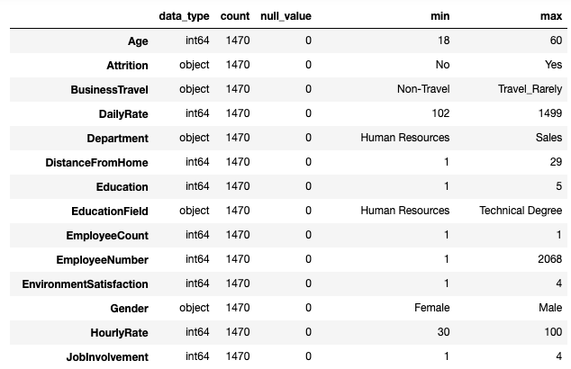
Data Collection
https://www.kaggle.com/pavansubhasht/ibm-hr-analytics-attrition-dataset
WA_Fn-UseC_-HR-Employee-Attrition.csv
1470 rows
35 columns

Slide 7
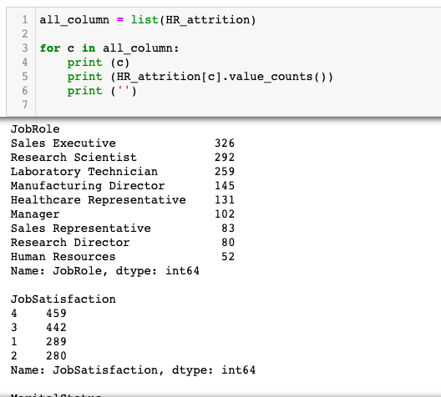
Understanding Your Dataset
Double checking the data

Slide 8
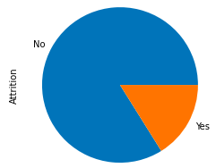
Understanding Your Dataset
There is no empty cells and the data category is clean
Imbalance class
For the target data, 16.1% of the dataset is attrition whereas 83.9% of the dataset is still currently employed by the company. I will stratify the train test and use weight adjusting techniques to prevent biasness.
Selection of encoding
Frequency encoding
Ordinal encoding
Standard scaler
Removal of columns
DailyRate and HourlyRate as it is covered in the MonthlyRate (Duplication)
Over18 as it is covered in Age (Duplication)
EmployeeCount and EmployeeNumber as it is no material effect
StandardHours as it is 80 for everyone and hence no material effect

Slide 9
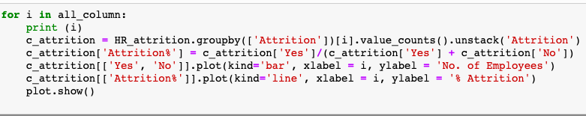
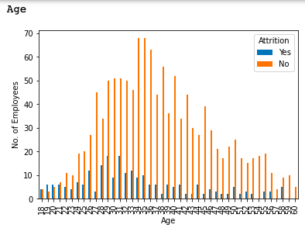
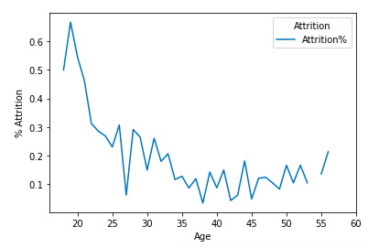
Derive Hypothesis and Key Insights
Employees aged 25 and below is likely to attrite
They are still trying to figure out if this job suits them
They just happens to have better opportunities
Recommend to keep them engaged

Slide 10
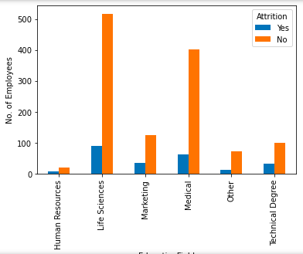
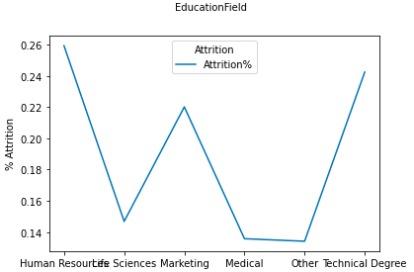
Derive Hypothesis and Key Insights
Employees studying Life Sciences and medical is more loyal
Data is significant
This should be a pharmaceutical company
May want to consider improving the benefits structure for the other departments

Slide 11
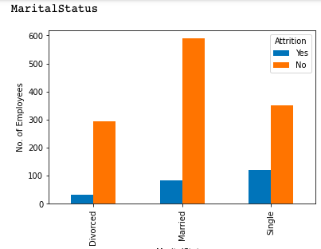
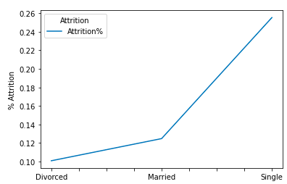
Derive Hypothesis and Key Insights
Singles have a higher rate of attrition
Divorced have lowest rate of attrition
Should be due to financial obligations

Slide 12
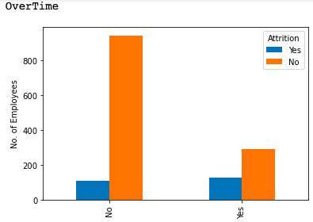
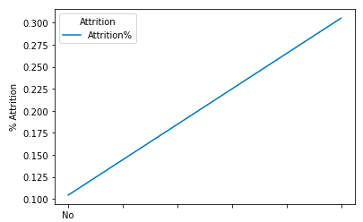
Derive Hypothesis and Key Insights
Those worker who is having overtime is more likely to attrite
Need to review workload and scheduling
Also to investigate if there is any overtime salary

Slide 13
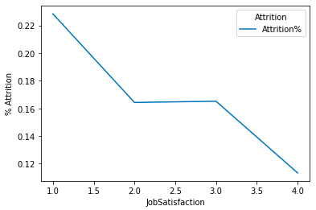
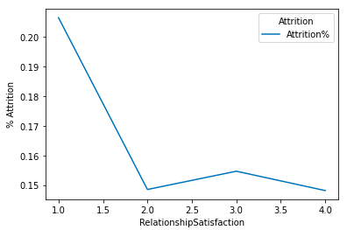
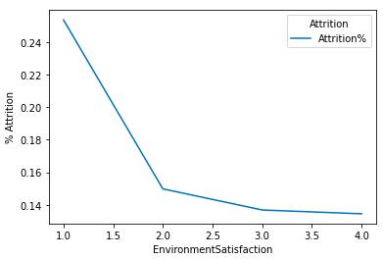
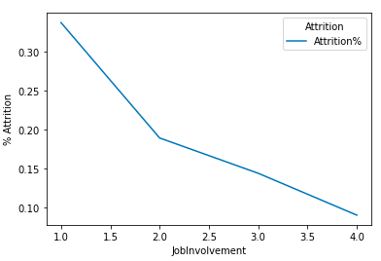
Derive Hypothesis and Key Insights
Find out who these employees are
Detect and engage those with high performances rating to prevent attrition

Slide 14
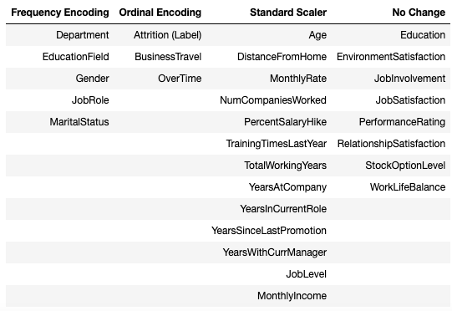
Data Preparation (Encoding)

Slide 15
Base Model Selection and Training
KNN (K nearest neighbour)
RF (Random foreest)
LR (Logistic regression)
SVM (Support vector machine)
Gradient Boosting
Adaboost
Naive Bayes

Slide 16
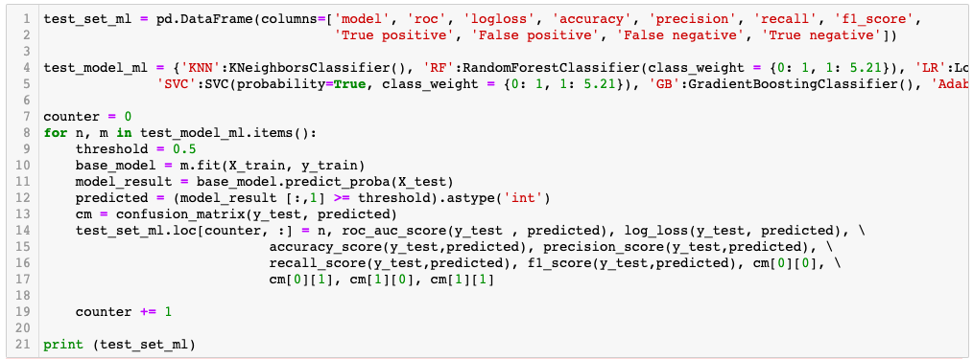
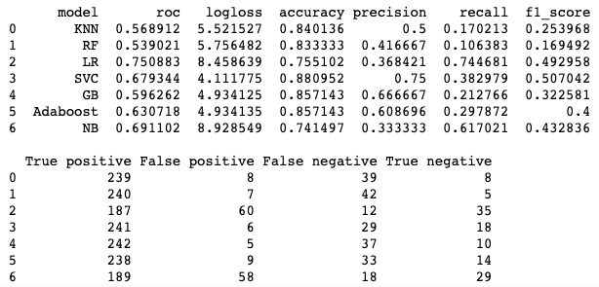
Base Model Selection and Training

Slide 17
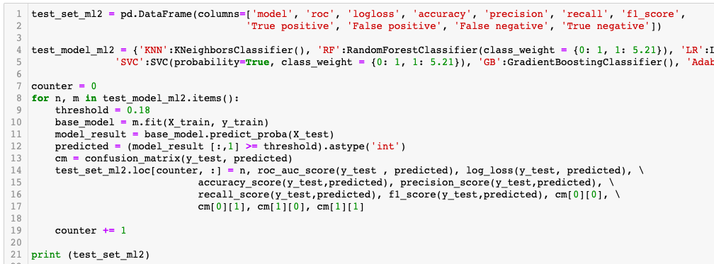
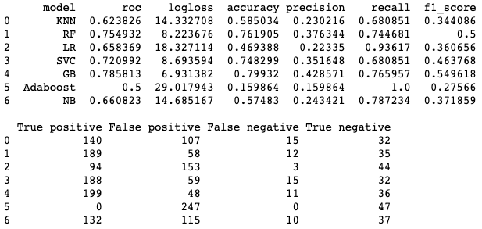
Base Model Selection and Training

Slide 18
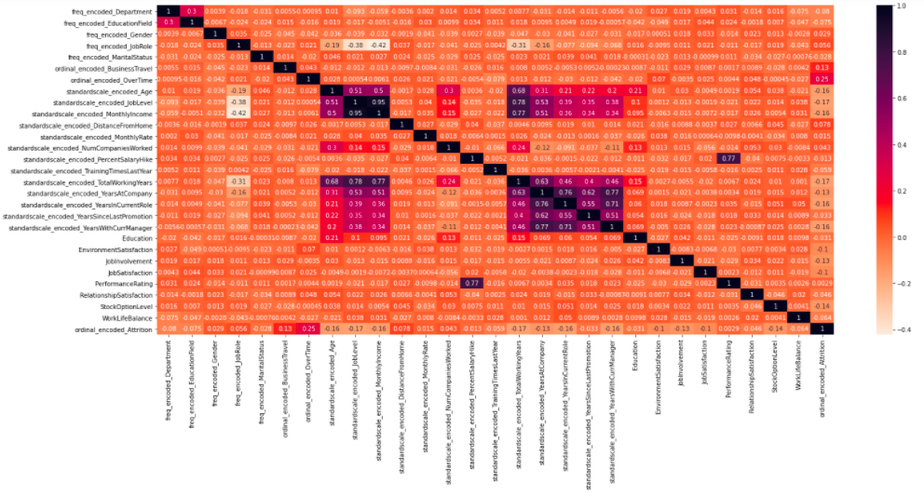
2) Exploratory Data Analysis

Slide 19
Feature Engineering
TotalWorkingYears
YearsAtCompany
YearsInCurrentRole
YearsSinceLastPromotion
YearsWithCurrentManager
JobLevel
MonthlyIncome
Age
PerformanceRating
PercentSalaryHike
Time
Based
Age
Based
Performance
Based

Slide 20
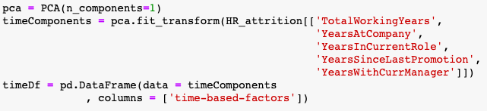
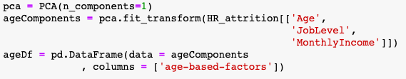
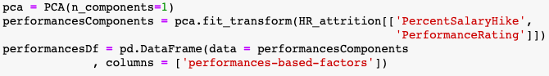
Feature Engineering

Slide 21
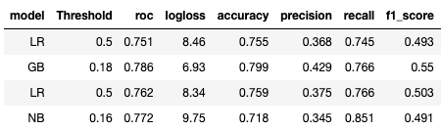
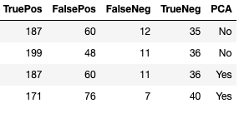
Model Evaluation

Slide 22
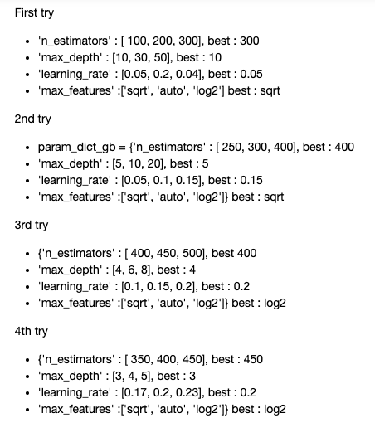
Hyper- parameter Turning

Slide 23
Final Model Selection

Slide 24
Key Learning
Find out ways to handle big dataset
Improving quality of code
More use of loops instead of plotting 1 by 1
More often then not, the dataset will be imbalanced, need to understand more methods (e.g. SMOTE, oversampling)
Need to gain a deeper understanding on the parameter for each model for tuning
Feature importance graph, need to be able to link the feature number to the features
https://github.com/CasperPeh/ML_Predict_Employee_Attrition

